Slide 1







IEEE SSH 2024
HACKATHON
KATHON

Slide 2



Team name: Smart Stop
Team Members name:
Shaunak Hawaldar
Devesh Dabhade
Manasi Choudhari

Slide 3


Problem statement
Open Innovation for citizen - led Smart City Software Solutions
How might we create a platform that enables citizens, urban planners, and developers to co-create and implement open-source software solutions for smart cities, focusing on areas like traffic management, energy efficiency, and public safety?

Slide 4

Solution
This project aims to decongest the heavy traffic on the Indian roads, caused due to the current fixed time signal systems.
It also aims to :
Dynamically change the duration of signals, based on the volume of traffic at different times of the day
Using Deep Learning algorithm, Convolutional Neural Network (CNN), to increase the efficiency of traffic management .
Providing real-time traffic condition forecasts for scheduling the traffic signal controls.

Slide 5
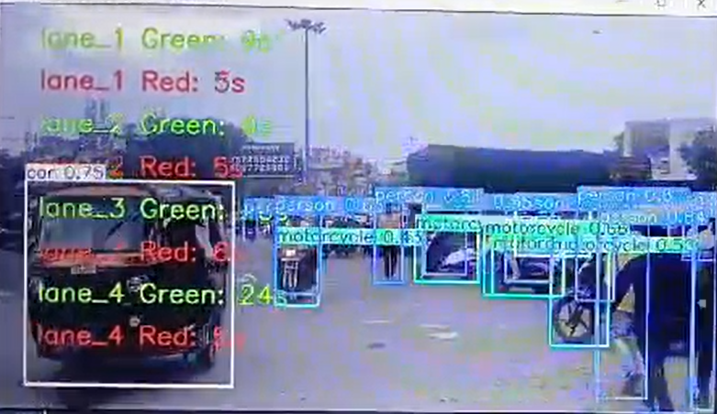
Collection of Data (Manually and through government recordings.
Preprocessing: Labelling and Annotations through Roboflow.
Analyse and train model using YOLO V8.
Apply model with code and data: vehicle detection, traffic density and volume.
Check results and integrate with website showing real time traffic timings .

Slide 6

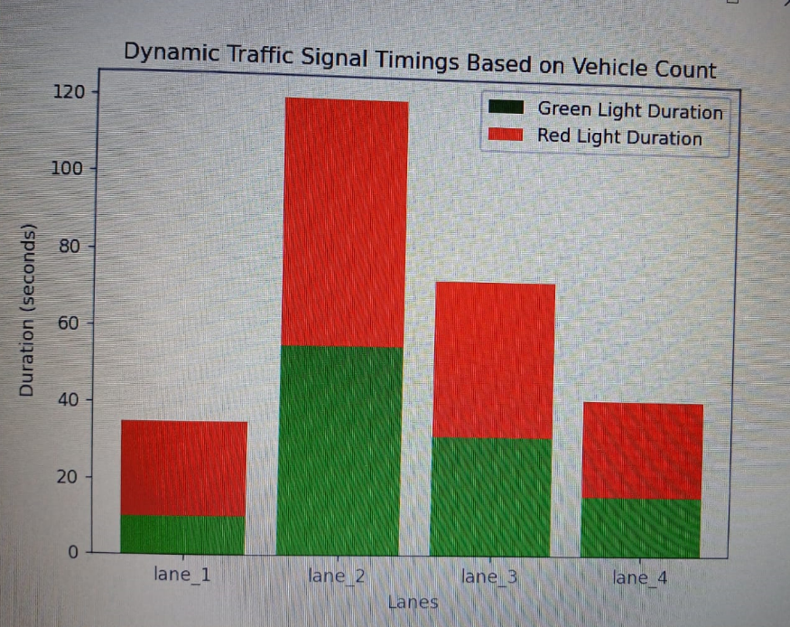

USP
Saves Time and Money (Fuel + maintenance cost)
Enables control of high traffic flow points
Increased precision of measuring traffic density
Reduced fuel consumption
Reduced carbon footprint

Slide 7
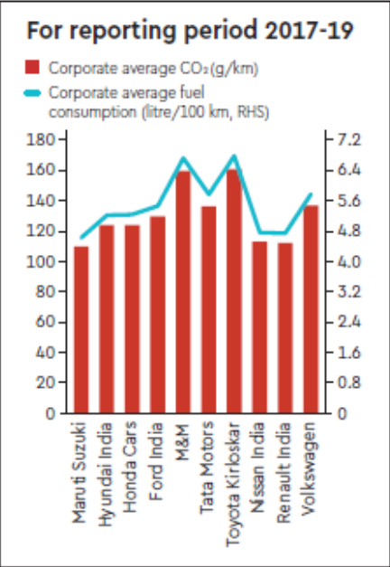
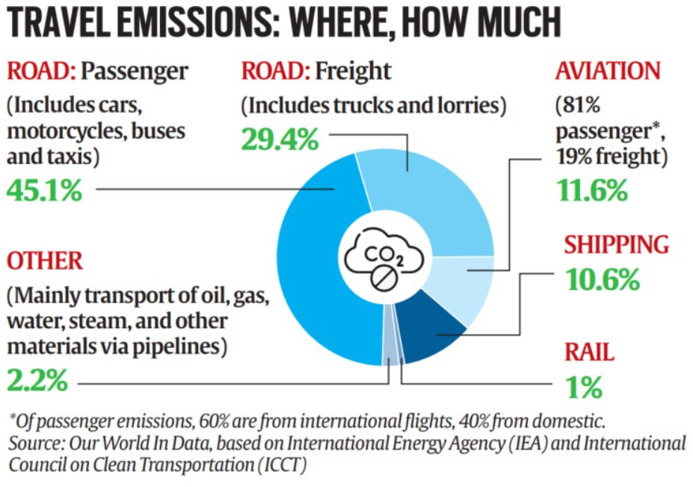
Energy Consumption & Pollution Control
On an average, a car spends 15-20 minutes at red traffic signals each day. During this time, around 200ml of fuel is wasted.
If this waiting time is reduced by around 5-10 minutes , the fuel wastage may also reduce by almost 50% . Consequently , less emissions would be recorded and hence , the Carbon Footprint would gradually reduce , thereby reducing the pollution and improving the AQI of cities . It would also aid in improving our ecosystem in the long run.

Slide 8


s
Tech Stack
DATA PROCESSING & MONITORING
Roboflow
Grafana
WEBSITE
Python: Quart (Flask-like) web framework
Express framework
Javascript: Chart.js
AI & ML
Roboflow
OpenCV
YOLOv8 Algorithm
TensorFlow
PyTorch
DATABASE
Mongodb
IOT & SENSORS
Raspberry Pi or Arduino
Ultrasonic Sensors , Sound Sensors & Camera Systems
Notes:
Numpy, OpenCV , pyaudio , pymongo , keras , tensorflow , pytorch

Slide 9

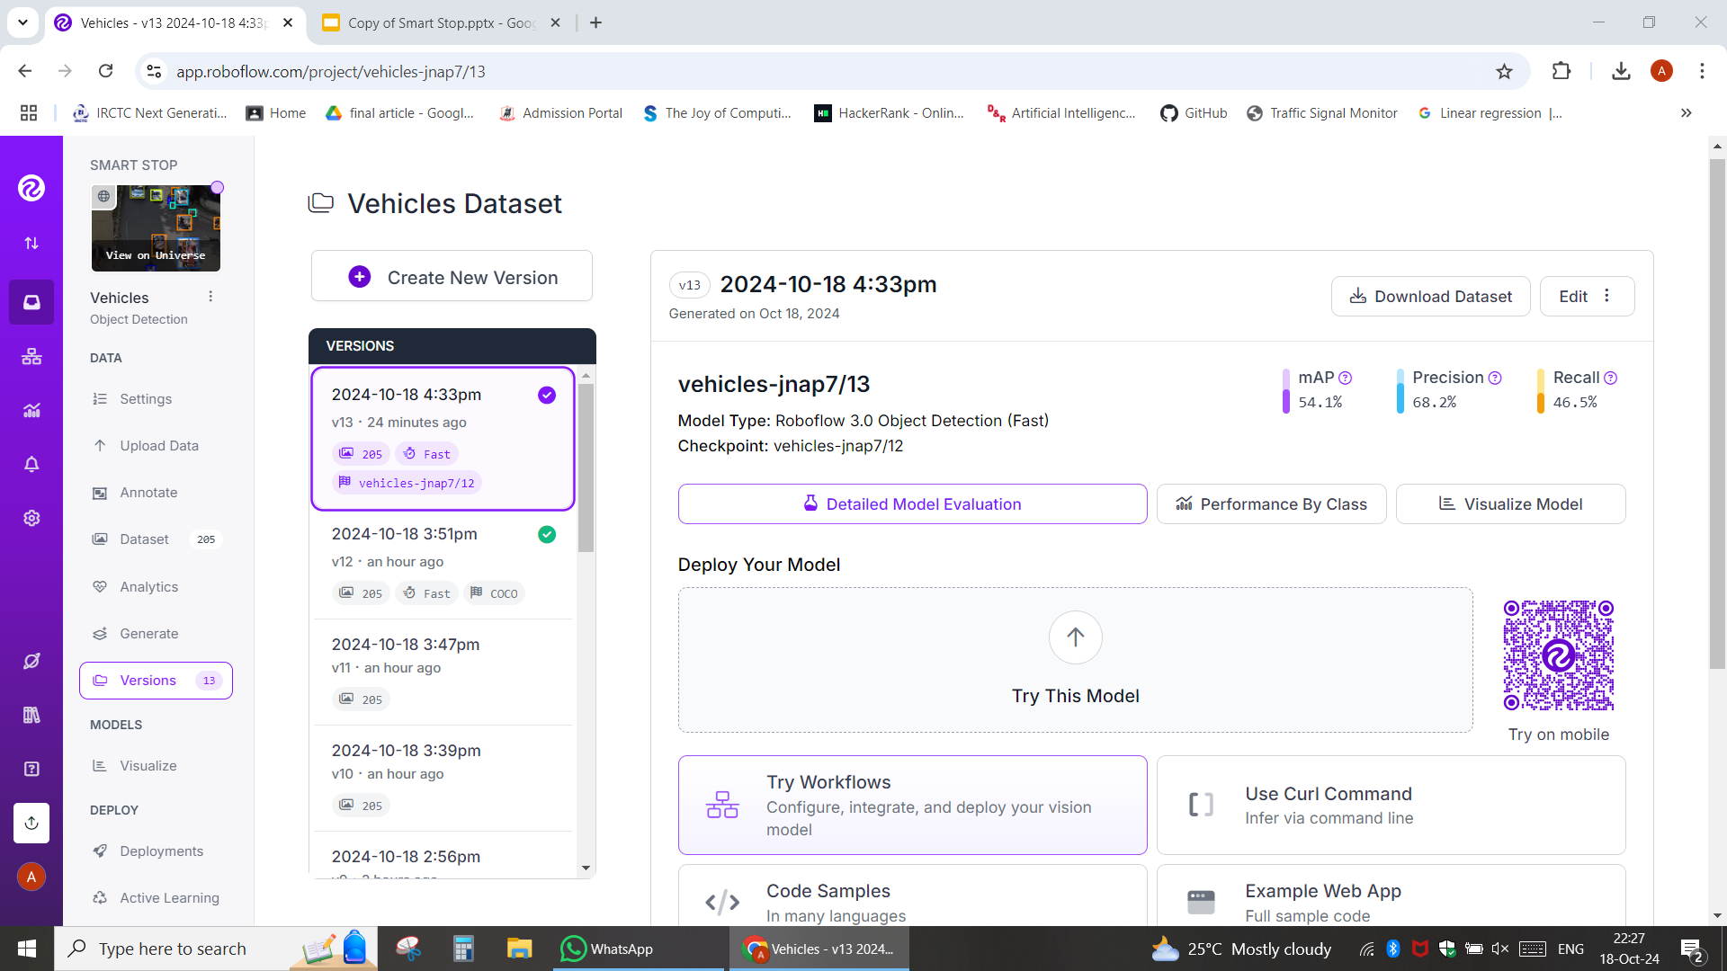


Slide 10
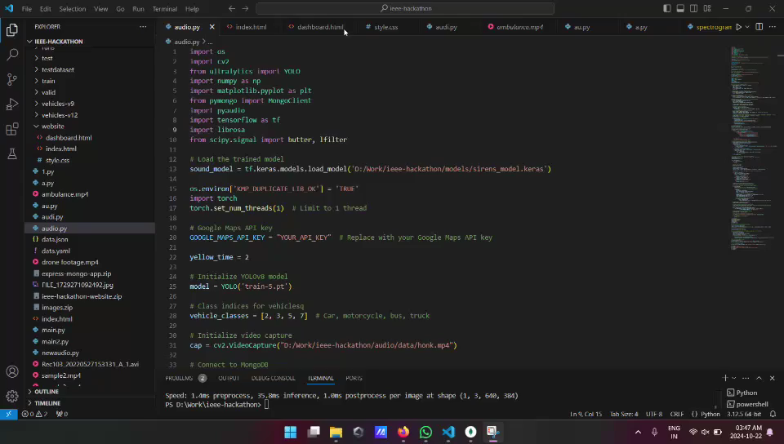
Dynamic Traffic Signal Time Change after detection of an Emergency Vehicle

Slide 11
Future Prospects
Smart City Integration
Enhancing the effectiveness of emergency services .
3.AI integration in traffic control.
4.Human convenience + promoting sustainability
5.Integration with Google Maps for increased location and traffic density accuracy
6.Citizen Grievances addressal (Eg. – Potholes , Unsafe infrastructure)

Slide 12
References
[1] Bajaj, Mr.Ratan. (2023). A research paper on AI for traffic management. 10.13140/RG.2.2.21119.69287.
[2] K M, Sujith & S, Nikhil. (2019). Introducing Artificial Intelligence in Traffic Management for a Sustainable Urban Development.
[3] Shridevi Jeevan Kamble, Manjunath R Kounte, Machine Learning Approach on Traffic Congestion Monitoring System in Internet of Vehicles, Procedia Computer Science, Volume 171,2020,Pages 2235-2241, ISSN 1877-0509, https://doi.org/10.1016/j.procs.2020.04.241.
[4] Y. Qin, H. Luo, F. Zhao, C. Wang, J. Wang and Y. Zhang, "Toward Transportation Mode Recognition Using Deep Convolutional and Long Short-Term Memory Recurrent Neural Networks," in IEEE Access, vol. 7, pp. 142353-142367, 2019, doi: 10.1109/ACCESS.2019.2944686.
Thank You

